Slide 1
LeBron James
By Devin Cheek

Slide 2
LeBron James was born
LeBron James was born in December 30, 1984

Slide 3
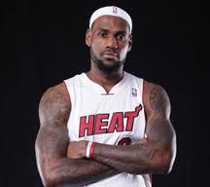
LeBron James

Slide 4
Hometown and family
He was born in Akron Ohio and has two sons, no brothers or sisters.

Slide 5
About LeBron James
He is the youngest person on his team. He scored 2000 team points. He had some hard times in his kid times.

Slide 6
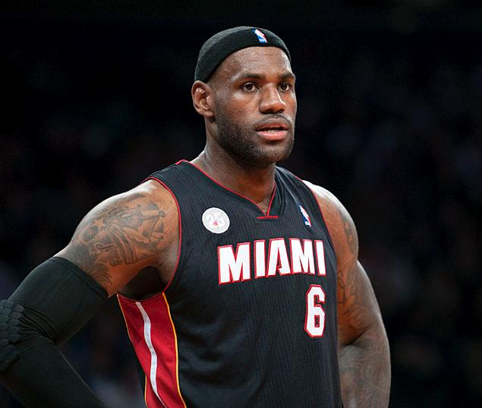
LeBron James

Slide 7
How He changed our lives
He had a lot of MVPs.

